Slide 1
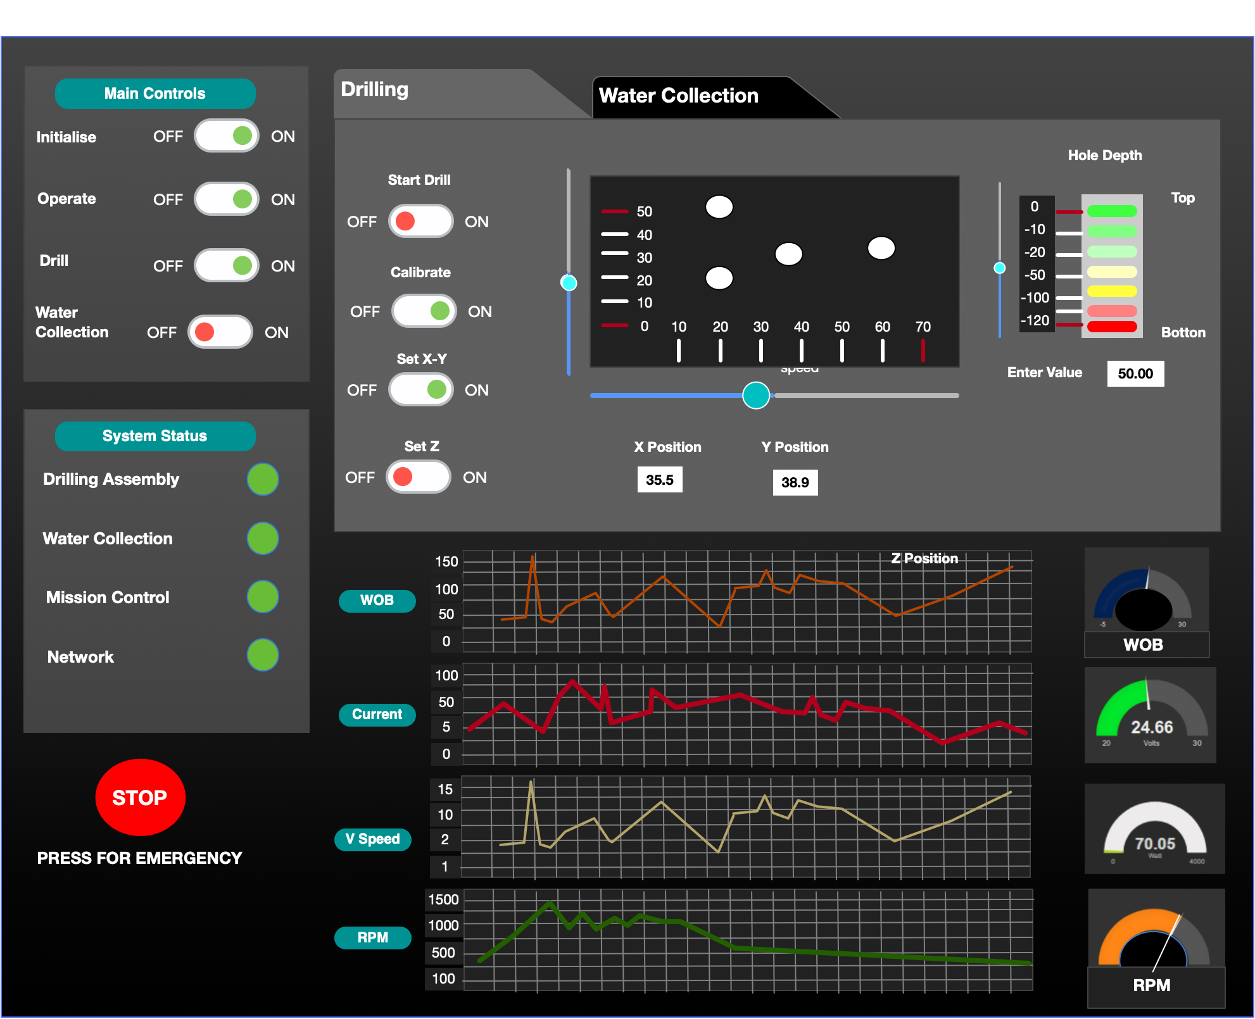
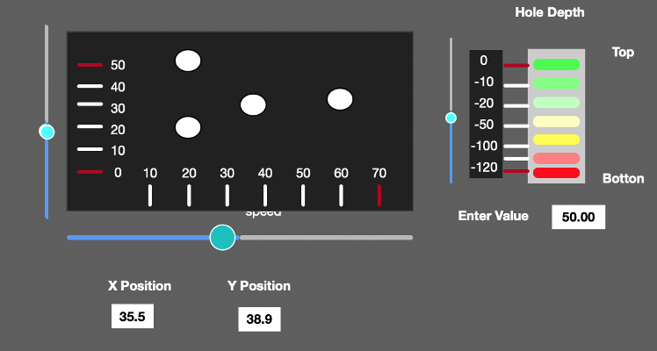
Develop this screen first
Program 01 (P01): Startup, Diagnostics and Calibration
Note: any text in grey background is an input box for the user to enter values. The default values are shown.
E-Stop (Press ESC) ◉ Mode selection 01 Startup/calibrate◉
02 Home Z1, Z2 ◉
03 Move X, Y ◉
04 Drill borehole ◉
05 Case borehole ◉
06 Insert heater ◉
07 Mine water ◉
08 Data download ◉
09 Troubleshoot ◉
P01 – Startup & Diagnostics Controls
Start mission clock ▶️ ⏹…
Power cycle 5VDC (RPi) ▶️ ⏹… Power cycle 24VDC bus ▶️ ⏹…
Power cycle 75VDC bus ▶️ ⏹…
Home Z1 axis servo ▶️ ⏹…
Home Z2 axis servo ▶️ ⏹…
Home X axis servo ▶️ ⏹…
Home Y axis servo ▶️ ⏹…
Spin drill motor ▶️ ⏹…
Spin pump ▶️ ⏹…
Test heater ▶️ ⏹…
P01 – Calibration Controls
Set sampling rate ….50.. Hz
Set air gap to regolith …17.. cm
Set max Z1 travel length 117.. cm Set current limits soft .6A max .8A
Set WOB limit soft 100N max 140N Set RPM limit soft 80% max 100%
Set global servo torque limits Z1.100.% Z2.20. % X.50.% Y.25.%
Calibrate Z1 axis ▶️ ⏹…
Calibrate Z2 axis ▶️ ⏹…
Calibrate X axis ▶️ ⏹…
Calibrate Y axis ▶️ ⏹…
Calibrate WOB ▶️ ⏹…
Calibrate tachometer ▶️ ⏹…
XY design is fine as is Z1-Z2 design, see new proposal, what do you think? Dials: Great start, let’s build on it! Show all four dials with a uniform interface: large boldface names for all, value for WOB and RPM at 0 decimal places but current and ROP in 1 decimal, graphical dial as shown. values with font colors depending on soft / hard limits chosen above. WOB in N, overall range 0 to 250N, green: [0 to soft limit] orange: [soft to hard], red: [hard up to 250]
Similarly for
AMPS in A, (0 – 10) ROP in mm/sec, (-10 to +10) RPM in rpm (0 – 1400)
System status Mains supply: 114VAC
24VDC bus ◉
75VDC bus ◉
Network ◉
Heartbeat 1 ◉
Heartbeat 2 ◉
Heartbeat 3 ◉
Z1 axis servo ◉
Z2 axis servo ◉
X axis servo ◉
Y axis servo ◉
Drill motor ◉
Pump ◉
Heater ◉
Current: 0.7A
Mission time: +0h12m
Z1: -5cm
Z2: 0cm
0CM
17cm
?? cm
Show live, real-time total current draw of system here. Font colors: green if <soft limit, orange if >soft and <hard, red if >hard
117cm
Z1 POS: -10CM Z2 POS: 0CM

Slide 2
Copy P01 screen and then amend it
Program 02 (P02): Return Z1 and Z2 axes to home position
E-Stop (Press ESC) ◉ Mode selection 01 Startup/calibrate◉
02 Home Z1, Z2 ◉
03 Move X, Y ◉
04 Drill borehole ◉
05 Case borehole ◉
06 Insert heater ◉
07 Mine water ◉
08 Data download ◉
09 Troubleshoot ◉
P02 – Return Z1 axis to home position
Set Z1 homing options
Timeout to stop if not homed 60 sec
Spin drill while homing and in regolith? RPM 0%
Z1 vertical speed while homing? Rate of Ascent (ROA) 20mm/sec
Z1 servo homing torque limits when in air 10% in regolith 80 %
Homing of Z1 (drill) axis
Start homing Z1 (drill) axis ▶️ ⏹…
P02 – Return Z1 axis to home position
Set Z2 homing options
Timeout to stop if not homed 60 sec
Activate heater while homing and in regolith? ▶️ ⏹… Activate pump in filter cleaning mode while homing and in regolith? ▶️ ⏹…
Z2 vertical speed while homing? Rate of Ascent (ROA) 20mm/sec
Z2 servo homing torque limits when in air 10% in regolith 20 %
Homing of Z2 (heater) axis
Start homing Z2 (heater) axis ▶️ ⏹…
Program notes
- User can enter choose to enter P02 manually at any time, using the mode selection controls (upper left). Often, the user will come to P02 following a hit of the ESC button. See slide notes for full details of ESC button.
- In mode P02, where we are moving Z1 and Z2 up to home position, the X and Y position is soft-locked. However, if the operator is trying to manually unjam a stuck drill bit, it may be helpful to allow very small nudges in the X+, X-, Y+ and Y- directions which are then reverted automatically back to the soft-locked X and Y coordinates. This simulates an operator moving a stuck drill bit laterally to open up the hole and escape.. Therefore, UI note – lock the values in the X and Y position boxes (user can’t edit them in P02), and interpret movements of the sliders as nudges in the desired direction which are executed and then immediately reverted
Same notes as before for dials…
Dials: Great start, let’s build on it! Show all four dials with a uniform interface: large boldface names for all, value for WOB and RPM at 0 decimal places but current and ROP in 1 decimal, graphical dial as shown. values with font colors depending on soft / hard limits chosen above. WOB in N, overall range 0 to 250N, green: [0 to soft limit] orange: [soft to hard], red: [hard up to 250]
Similarly for
AMPS in A, (0 – 10) ROP in mm/sec, (-10 to +10) RPM in rpm (0 – 1400)
System status Mains supply: 114VAC
24VDC bus ◉
75VDC bus ◉
Network ◉
Heartbeat 1 ◉
Heartbeat 2 ◉
Heartbeat 3 ◉
Z1 axis servo ◉
Z2 axis servo ◉
X axis servo ◉
Y axis servo ◉
Drill motor ◉
Pump ◉
Heater ◉
Current: 0.7A
Mission time: +0h16m
Z2: 0cm
Z1: -15cm
0CM
17cm
?? cm
117cm
Z1 POS: 0CM Z2 POS: 0CM
Notes:
User can abort to here from any of the programs P04, P05, P06, P07… They simply press ESC which puts the system into P09, and then they can select P02.
Here is what happens when a user presses ESC (triggers the Emergency Stop)
All four servo motors are stopped, if any were moving
Drill motor is stopped
Heater is turned off
Pump is stopped (with a 4 seconds delay)
The state of all variables in the stopped routine is recorded just before stopping the above.
The program number is changed to P09 (Troubleshooting)
If the user subsequently decides to continue the operation by returning to their original program and pressing PLAY they will be given the option to resume the previously interrupted operation.

Slide 3
Copy P02 screen and then amend it
Program 03 (P03): Moving to a new X, Y location
E-Stop (Press ESC) ◉ Mode selection 01 Startup/calibrate◉
02 Home Z1, Z2 ◉
03 Move X, Y ◉
04 Drill borehole ◉
05 Case borehole ◉
06 Insert heater ◉
07 Mine water ◉
08 Data download ◉
09 Troubleshoot ◉
P03 – Move Base to new X location
Set X movement options
Time to execute move 10 sec
X axis speed while translating? 10mm/sec
X servo translation torque limit 20% (global max limit: 50%)
Translation of X (base) axis
Move towards X-axis motor (+)
by +5cm ▶️ ⏹… by +0.1cm ▶️ ⏹…
Move away from X-axis motor (-)
by -5cm ▶️ ⏹… by -0.1cm ▶️ ⏹…
P03 – Move frame to new Y location
Set Y movement options
Time to execute move 10 sec
Y axis speed while translating? 10mm/sec
Y servo translation torque limit 20% (global max limit: 25%)
Translation of Y (frame) axis
Move towards Y-axis motor (+)
by +5cm ▶️ ⏹… by +0.1cm ▶️ ⏹…
Move away from Y-axis motor (-)
by -5cm ▶️ ⏹… by -0.1cm ▶️ ⏹…
Program notes
In mode P03, where we are moving X and Y axes to a new location to drill a new hole, the Z1 and Z2 axes must be at the home position.
Therefore, UI note – lock the values in the Z1 and Z2 position boxes (user can’t edit them in P03)
Same notes as before for dials…
Dials: Great start, let’s build on it! Show all four dials with a uniform interface: large boldface names for all, value for WOB and RPM at 0 decimal places but current and ROP in 1 decimal, graphical dial as shown. values with font colors depending on soft / hard limits chosen above. WOB in N, overall range 0 to 250N, green: [0 to soft limit] orange: [soft to hard], red: [hard up to 250]
Similarly for
AMPS in A, (0 – 10) ROP in mm/sec, (-10 to +10) RPM in rpm (0 – 1400)
System status Mains supply: 114VAC
24VDC bus ◉
75VDC bus ◉
Network ◉
Heartbeat 1 ◉
Heartbeat 2 ◉
Heartbeat 3 ◉
Z1 axis servo ◉
Z2 axis servo ◉
X axis servo ◉
Y axis servo ◉
Drill motor ◉
Pump ◉
Heater ◉
Current: 0.9A
Mission time: +0h22m
Z1: 0cm
Z2: 0cm
0CM
17cm
?? cm
117cm
Z1 POS: 0CM Z2 POS: 0CM

Slide 4
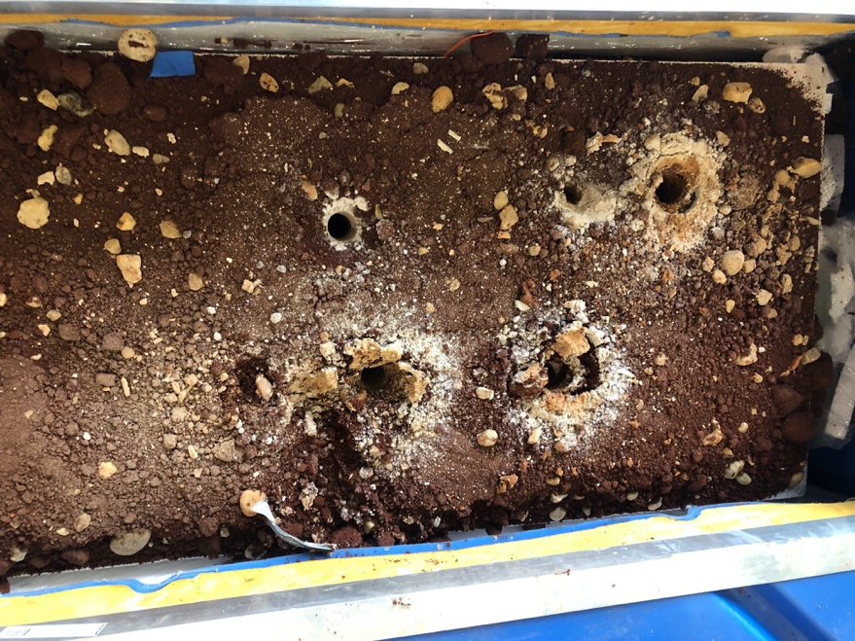
Copy P03 screen and then amend it
Program 04 (P04): Drilling a new borehole
E-Stop (Press ESC) ◉ Mode selection 01 Startup/calibrate◉
02 Home Z1, Z2 ◉
03 Move X, Y ◉
04 Drill borehole ◉
05 Case borehole ◉
06 Insert heater ◉
07 Mine water ◉
08 Data download ◉
09 Troubleshoot ◉
P04 – Drilling new borehole
Time to execute move 10 sec
Z1 axis max ROP 06mm/sec
Max WOB before limiting ROP
120 N
Z1 servo torque limit 80% (global limit: 100%) Drill max RPM
80% (global limit: 100%)
REAM towards Z1-motor (+)
by +5cm ▶️ ⏹…
DRILL away fm Z1-motor(-)
by -5cm ▶️ ⏹…
Hole elapsed time: 3.2min Current Depth: -55cm Average ROP: -2 mm/sec Average power draw: 700W
Z2: 0cm
0CM
Same notes as before for dials…
Dials: Great start, let’s build on it! Show all four dials with a uniform interface: large boldface names for all, value for WOB and RPM at 0 decimal places but current and ROP in 1 decimal, graphical dial as shown. values with font colors depending on soft / hard limits chosen above. WOB in N, overall range 0 to 250N, green: [0 to soft limit] orange: [soft to hard], red: [hard up to 250]
Similarly for
AMPS in A, (0 – 10) ROP in mm/sec, (-10 to +10) RPM in rpm (0 – 1400)
Program notes
- In mode P04, where we are moving Z1 vertically for drilling, the X and Y position is locked.
17cm
Z1: -55cm
?? cm
System status Mains supply: 114VAC
24VDC bus ◉
75VDC bus ◉
Network ◉
Heartbeat 1 ◉
Heartbeat 2 ◉
Heartbeat 3 ◉
Z1 axis servo ◉
Z2 axis servo ◉
X axis servo ◉
Y axis servo ◉
Drill motor ◉
Pump ◉
Heater ◉
Current: 5.7A
Mission time: +0h32m
117cm
Z1 POS:-70CM Z2 POS: 0CM
The backgrounds here need to have high contrast with the lines. Probably white. Also, we will need to organize screen to fit a few more strip charts – perhaps three more, one for each acoustic frequency range (see slide notes)
Notes:
Summary of acoustics at 3 frequency ranges (determined experimentally) with real-time and max amplitude (or other characteristics as experimentally determined)
The video screen (photo, in white border) is coming from a separate program and is a floating window that the user can move around and resize or place on top of whatever isn’t important in the UI. It should still allow focus of mouse and keyboard to stay with the program even when it floats on top.

Slide 5
Copy P04 screen and then amend it
Program 05 (P05): Casing the borehole
E-Stop (Press ESC) ◉ Mode selection 01 Startup/calibrate◉
02 Home Z1, Z2 ◉
03 Move X, Y ◉
04 Drill borehole ◉
05 Case borehole ◉
06 Insert heater ◉
07 Mine water ◉
08 Data download ◉
09 Troubleshoot ◉
P05 – Casing the borehole
Target final borehole depth -100 cm
Intermediate depths
-80 cm -90 cm
Z1 axis drilling ROP - 2mm/sec
WOB limit for ROP
100 N
Z1 axis reaming ROA +15mm/sec
Z1 axis translating ROP - 10mm/sec Drill max RPM
100% (global limit: 100%)
Execute casing routine:
▶️ ⏹…
Verify borehole depth:
▶️ ⏹…
Hole elapsed time: 8.2min Current Depth: -75cm Target borehole depth: -100cm Actual hole depth: TBD
Program notes
- In mode P05, where we are moving Z1 vertically for casing the borehole, the X and Y position is locked. The borehole casing routine is used to mix meltwater with cuttings and clear the hole. See slide notes for full details of the hole casing routine.
Z2: 0cm
0CM
Same notes as before for dials…
Dials: Great start, let’s build on it! Show all four dials with a uniform interface: large boldface names for all, value for WOB and RPM at 0 decimal places but current and ROP in 1 decimal, graphical dial as shown. values with font colors depending on soft / hard limits chosen above. WOB in N, overall range 0 to 250N, green: [0 to soft limit] orange: [soft to hard], red: [hard up to 250]
Similarly for
AMPS in A, (0 – 10) ROP in mm/sec, (-10 to +10) RPM in rpm (0 – 1400)
17cm
Z1: -75cm
?? cm
System status Mains supply: 114VAC
24VDC bus ◉
75VDC bus ◉
Network ◉
Heartbeat 1 ◉
Heartbeat 2 ◉
Heartbeat 3 ◉
Z1 axis servo ◉
Z2 axis servo ◉
X axis servo ◉
Y axis servo ◉
Drill motor ◉
Pump ◉
Heater ◉
Current: 5.7A
Mission time: +0h37m
117cm
Z1 POS: 0CM Z2 POS: 0CM
The backgrounds here need to have high contrast with the lines. Probably white. Also, we will need to organize screen to fit a few more strip charts – perhaps three more, one for each acoustic frequency range (see slide notes)
Notes:
User specifies two intermediate depths, let these be d1 and d2, and a final target depth, let that be d3.
In what follows, the user can interrupt the Z1 movement at any time by pressing “stop”: this will reduce drill RPM to 50% of specified and stop vertical motion. If the routine is stopped, it will move back up to above the first intermediate depth, d1 when restarted.
When the borehole casing routine is started (play is pressed), the drill starts descending (away from motor, - direction) at the Z1 axis drilling ROP rate, with RPM at half of the max limit, with the parameters as specified above by the user. This grinds the ice and produces water which mixes with the regolith cuttings that are on the bit or which have fallen in the hole. Usual control law for limiting ROP based on WOB limits applies.
When the second intermediate depth, d2, is reached the Z1 axis stops, the drill spins up to the max specified RPM, and then after 3 seconds at full RPM the Z1 axis starts moving up (toward the motor, + direction) at the reaming ROA (Rate of Ascent) rate. This reams the borehole and sends mud and water up and around the borehole walls. This upward reaming and casing action continues until the first intermediate depth, d1, is hit.
At that point, the Z1 axis stops again, the drill RPM is reduced to 50% of the setting, and the Z1 axis descends (away from motor, - direction) at the Z1 axis translating ROP as specified. When WOB rises suddenly from zero, or when the depth exceeds the second intermediate depth, d2, (whichever occurs first), the Z1 axis speed is reduced to Z1 axis drilling ROP setting as specified. Usual control law for limiting ROP based on WOB limits applies, and drilling in ice continues until the target borehole depth, d3, is hit.
At that point, the Z1 axis stops again, the drill spins up to the max specified RPM, and then after 3 seconds at full RPM the Z1 axis starts moving up (toward the motor, + direction) at the reaming ROA (Rate of Ascent) rate. This (hopefully) clears the ice hole from cuttings and reams the borehole for a second time, sending mud and water up and around the borehole walls. This upward reaming and casing action continues until the first intermediate depth, d1, is hit. At that point, the casing routine ends.
At this point, the hole should be ready for use. The user would normally proceed to program P06 to replace the drill bit with the heater.
Optionally, the routine “verify borehole depth” can be used to measure the actual depth of the borehole. This routine stops the drill completely and lowers the Z1 axis (away from motor, -direction) at the Z1 axis translating speed specified in vertical distance increments equal to (d3 – d2) / 2 , while watching the WOB meter. If the WOB spikes during movement, the descent is stopped for 0.2 seconds, the depth is recorded, the drill bit retracts at the Z1 reaming ROA speed, and the verified borehole depth is displayed in the box in the upper right window. If the WOB doesn’t spike during movement, the user can re-engage the verification routine.

Slide 6
Copy P02 screen and then amend it
Program 06 (P06): Translate frame and insert heater in borehole
E-Stop (Press ESC) ◉ Mode selection 01 Startup/calibrate◉
02 Home Z1, Z2 ◉
03 Move X, Y ◉
04 Drill borehole ◉
05 Case borehole ◉
06 Insert heater ◉
07 Mine water ◉
08 Data download ◉
09 Troubleshoot ◉
Hole elapsed time: 15.2min Current heater depth: -90cm Target borehole depth: -100cm Actual borehole depth: 98cm
Program notes
In mode P06, while we are moving Z1 up to home position and lowering Z2 into the hole, the X and Y position is soft-locked. However, if during Z2 descent the operator is trying to manually unjam a stuck heater boom, it may be helpful to allow very small nudges in the X+, X-, Y+ and Y- directions which are then reverted automatically back to the soft-locked X and Y coordinates IFF these nudges exceed +/- 0.5cm of cumulative translation relative to original hole center-axis coordinates. This simulates an operator adjusting the center of the heater axis to try to match the hole center axis. Therefore, UI note – lock the values in the X and Y position boxes (user can’t edit them in P06), and interpret movements of the sliders as nudges in the desired direction which are executed and NOT reverte unless they exceed a maximum of +/- 0.5cm from the original X,Y coordinate
P06 – Return Z1 axis to home position and translate Y frame axis
Set Z1 homing options
Timeout to stop if not homed 60 sec
Spin drill while in regolith? RPM 0%
Z1 vertical speed while homing? Rate of Ascent (ROA) 20mm/sec
Z1 servo homing torque limits when in air 10% in regolith 80 %
1. Homing of Z1 and Z2 axes
Start homing Z1 and then Z2 axes ▶️ ⏹…
2. Put heater over hole
Start translating Y (frame) axis ▶️ ⏹…
3. Put drill bit over hole
Start translating Y (frame) axis ▶️ ⏹…
P06 –Lower heater (Z2) into borehole Set Z2 lowering options
Desired heater depth 98 cm
Timeout to stop if not done 60 sec
WOB limit to interrupt descent: 25 N
Z2 vertical speed while descending? Rate of Descent (ROD) 20mm/sec
Z2 servo descent torque limits when in air 10% in regolith 20 %
Activate heater while descending and in regolith? ▶️ ⏹… Activate pump in filter cleaning mode while descending and in regolith? ▶️ ⏹…
Lowering of heater (Z2 axis)
Start lowering heater (Z2 axis) ▶️ ⏹…
Raising of heater (Z2 axis)
Raise heater (Z2 axis) by 5 cm ▶️ ⏹…
Same notes as before for dials…
Dials: Great start, let’s build on it! Show all four dials with a uniform interface: large boldface names for all, value for WOB and RPM at 0 decimal places but current and ROP in 1 decimal, graphical dial as shown. values with font colors depending on soft / hard limits chosen above. WOB in N, overall range 0 to 250N, green: [0 to soft limit] orange: [soft to hard], red: [hard up to 250]
Similarly for
AMPS in A, (0 – 10) ROP in mm/sec, (-10 to +10) RPM in rpm (0 – 1400)
System status Mains supply: 114VAC
24VDC bus ◉
75VDC bus ◉
Network ◉
Heartbeat 1 ◉
Heartbeat 2 ◉
Heartbeat 3 ◉
Z1 axis servo ◉
Z2 axis servo ◉
X axis servo ◉
Y axis servo ◉
Drill motor ◉
Pump ◉
Heater ◉
Current: 0.7A
Mission time: +0h44m
Z1: -0cm
0CM
17cm
?? cm
Z2: -90cm
117cm
Z1 POS: 0CM Z2 POS: -90CM
Notes:
Notes
This program allows the user to home the Z1 axis, move the Y axis to place the heater over the hole, attempt to lower the heater. The default desired depth to lower the heater to is taken from “Target borehole depth” and/or “Actual borehole depth” of Program P05, but the user can edit those.
If lowering the heater triggers a WOB spike, the program stops and awaits user input. User can raise the heater in 5cm increments, nudge the X/Y axes up to 0.5cm, and try again. If it isn’t working after several attempts (=blocked hole), user can home the heater and then place the drill bit over the hole to go back to P05 and case the hole one more time.
When heater reaches target (or, actual, if available) borehole depth then the program has completed successfully and we are ready to begin water mining operations.
The video screen should be visible when using this mode, for visual verification that drill bit / water heater are in the correct locations relative to the hole

Slide 7
Copy P05 screen and then amend it
Program 07 (P07): Water ice mining
E-Stop (Press ESC) ◉ Mode selection 01 Startup/calibrate◉
02 Home Z1, Z2 ◉
03 Move X, Y ◉
04 Drill borehole ◉
05 Case borehole ◉
06 Insert heater ◉
07 Mine water ◉
08 Data download ◉
09 Troubleshoot ◉
Hole elapsed time: 21.2min Water production time: 6.2min LOW FLOW ALERT Current heater depth: -90cm Target borehole depth: -100cm Actual borehole depth: 98cm
P07 – Activate Heater and Pump Set water production options
Normal heater power 100% of max
Pump speed 100% of max
Low flow/pressure threshold for cleaning
30% of nominal flow/pressure
Reduced heater power for cleaning 80%
Pump speed during cleaning 30%
Length of cleaning cycle: 30sec
Time division of cleaning cycle
Blow 50% Settle 25% Pump 25%
Activate Heater and Pump
Enable heater and pump ▶️ ⏹…
Mark nominal flow & pressure: ▶️
Manual filter cleaning
Engage cleaning for 3 cycles ▶️ ⏹…
P07 –Lower heater further into borehole Set Z2 lowering options
Turn off heater while lowering: Yes
Maximum heater depth = actual borehole depth 98 cm
Timeout to stop if not done 10 sec
WOB limit to interrupt descent: 25 N
Z2 vertical speed while descending? Rate of Descent (ROD) 10mm/sec
Z2 servo descent torque limits when in air 10% in cavity 10 %
Lowering of heater (Z2 axis)
Lower heater (Z2 axis) by 5 cm ▶️ ⏹…
Raising of heater (Z2 axis)
Raise heater (Z2 axis) by 5 cm ▶️ ⏹…
Homing of Z2 (heater) axis
Start homing Z2 (heater) axis ▶️ ⏹…
Need new dials for this one
Dials: Same design rules in general as the drilling dials
WOB in N, overall range 0 to 30N, green: [0 to 5N orange: [5N to 10N, red: [10N to 30N]
WATTS in W, (0 to 1000) measures heater power if we can measure it…e.g. it can be a total system power minus a fixed overhead for computers, pump etc FLOW in ml/sec, (0 to +10), this is water flow rate, either measured or calculated, if possible.. Red font when low flow PRESSURE in Pascals (0 – 10,000) of the vacuum side of the pump. Red font when low pressure
TEMPERATURE in Celsius (0 – 1,500) of the heater cartridge
System status Mains supply: 114VAC
24VDC bus ◉
75VDC bus ◉
Network ◉
Heartbeat 1 ◉
Heartbeat 2 ◉
Heartbeat 3 ◉
Z1 axis servo ◉
Z2 axis servo ◉
X axis servo ◉
Y axis servo ◉
Drill motor ◉
Pump ◉
Heater ◉
Current: 6.7A
Mission time: +0h50m
WOB
Z1: -0cm
0CM
WATTS
17cm
FLOW & PRESSURE
?? cm
Z2: -90cm
TEMP
117cm
Z1 POS: 0CM Z2 POS: -90CM
Notes:
CONOPS
User sets some water production options (defaults are above) and then activates heater and pump together with one control.
From the video camera and other telemetry, user determines that nominal flow has been achieved, at that point user presses “Mark nominal flow and pressure”. This mark is used together with the thresholds to determine whether low flow is occurring.
At any point, either the program or the user can engage a filter cleaning routine. This routine has a user-specified number of cycles. Each cycle consists of:
Running the heater at the normal power setting specified above (e.g. 100% of max) while running pump in reverse, for X*BLOW% seconds (X=length of cleaning cycle, 30 seconds in the default example above but user can set, BLOW% = 50% by default but user can set). This should raise the level of the water, immerse the filter and mix the water with any dirt blown from the filter.
Reduce heater level to the reduced level during cleaning and turn off pump for duration X*SETTLE% seconds, to let large particles settle
Pumping out water, for X*PUMP% seconds
So in the example above, the cleaning cycle would run for 90 seconds in total, repeating each of the above steps 3 times.
It should be possible to skip out to program P08 to download and process data, and skip back to this program P07, without affecting the execution of this program. Maybe P08 shouldn’t be a separate program at all….?

Slide 8
Copy P07 screen and then amend it
Program 08 (P08): Data download and processing
E-Stop (Press ESC) ◉ Mode selection 01 Startup/calibrate◉
02 Home Z1, Z2 ◉
03 Move X, Y ◉
04 Drill borehole ◉
05 Case borehole ◉
06 Insert heater ◉
07 Mine water ◉
08 Data download ◉
09 Troubleshoot ◉
Hole elapsed time: 25.2min Water production time: 10.2min LOW FLOW ALERT Current heater depth: -95cm Target borehole depth: -100cm Actual borehole depth: 98cm
P07 Repeater– Activate Heater and Pump Set water production options
Normal heater power 100% of max
Pump speed 100% of max
Low flow/pressure threshold for cleaning
30% of nominal flow/pressure
Reduced heater power for cleaning 80%
Pump speed during cleaning 30%
Length of cleaning cycle: 30sec
Time division of cleaning cycle
Blow 50% Settle 25% Pump 25%
Activate Heater and Pump
Enable heater and pump ▶️ ⏹…
Mark nominal flow & pressure: ▶️
Manual filter cleaning
Engage cleaning for 3 cycles ▶️ ⏹…
P08 – Data download and processing Set data download options
Automatically download data file for last hole during P07 execution: Yes
Use results from previous holes as inputs to analysis of current hole: Yes
List of data files (click to re-download)
01 02 03 04 05 06 07 08 09 10
Analyze data file
View data file# 02 ▶️ ⏹…
Clean data file# 02 ▶️ ⏹…
Execute NN analysis of file# 02 ▶️ ⏹…
Use of results
Send results back to HYDRATION III ▶️ ⏹…
S
Print overburden layers to PDF ▶️ ⏹…
S
Need new dials for this one
Dials: Same design rules in general as the drilling dials
WOB in N, overall range 0 to 30N, green: [0 to 5N orange: [5N to 10N, red: [10N to 30N]
WATTS in W, (0 to 1000) measures heater power if we can measure it…e.g. it can be a total system power minus a fixed overhead for computers, pump etc FLOW in ml/sec, (0 to +10), this is water flow rate, either measured or calculated, if possible.. Red font when low flow PRESSURE in Pascals (0 – 10,000) of the vacuum side of the pump. Red font when low pressure
TEMPERATURE in Celsius (0 – 1,500) of the heater cartridge
System status Mains supply: 114VAC
24VDC bus ◉
75VDC bus ◉
Network ◉
Heartbeat 1 ◉
Heartbeat 2 ◉
Heartbeat 3 ◉
Z1 axis servo ◉
Z2 axis servo ◉
X axis servo ◉
Y axis servo ◉
Drill motor ◉
Pump ◉
Heater ◉
Current: 6.7A
Mission time: +0h54m
WOB
Z1: -0cm
0CM
WATTS
17cm
FLOW & PRESSURE
?? cm
Z2: -95cm
TEMP
117cm
Z1 POS: 0CM Z2 POS: -95CM
Notes:
CONOPS
During water production, user can start P08 without stopping P07.
The settings include an auto-download setting, and a “use results from previous holes to run the NN analysis”.
If file did not download automatically, user clicks on filename to get it.
(Filename = hole number, every borehole that exceeds air gap + 50 cm in length is saved with a sequential file name 01, 02, 03, etc…)
User can view the file and scroll through the rows and columns. Viewing the file also gives some summary stats – sampling rate, number of rows, etc.
User can clean the file before processing – this is a routine that saves the raw file somewhere else and replaces it in the UI with a cleaned version that is more suitable for processing by a neural net. Cleaning details TBD by coder of neural net, not adjustable through this UI. In the above example file 01 is orange (raw) and file 02 is green (cleaned). Files 03 to 10 are not available yet (greyed out, not underlined), only on second hole..
User can execute a NN analysis of the file, passing the parameter on whether the NN analysis should be naïve or whether it should take advantage of the results from the previous hole (not sure if that is possible, but let’s give that option to our NN coder).
Once the analysis completes, the results can be printed on PDF (for submission to the competition judges) and can also be sent back to HYDRATION, in case we want our control laws to use the predictions of the layers pre-emptively, e.g. user can pause before entering a tough layer and change some settings before continuing.

Slide 9
Copy P01 screen and then amend it
Program 09 (P09): Troubleshooting
This window displays vital statistics from the referring program. See notes section below.
E-Stop (Press ESC) ◉ Mode selection 01 Startup/calibrate◉
02 Home Z1, Z2 ◉
03 Move X, Y ◉
04 Drill borehole ◉
05 Case borehole ◉
06 Insert heater ◉
07 Mine water ◉
08 Data download ◉
09 Troubleshoot ◉
P09 – Troubleshooting
Pause mission clock ▶️ ⏹…
Power cycle 5VDC (RPi) ▶️ ⏹… Power cycle 24VDC bus ▶️ ⏹…
Power cycle 75VDC bus ▶️ ⏹…
Servo troubleshoot speed: 1 mm/sec
Home Z1 axis servo ▶️ ⏹…
Home Z2 axis servo ▶️ ⏹…
Home X axis servo ▶️ ⏹…
Home Y axis servo ▶️ ⏹…
Spin drill motor 10% ▶️ ⏹…
Spin pump +/-10% ▶️ ⏹…
Test heater 10% ▶️ ⏹…
Referring program controls
Control action 1 ▶️ ⏹…
Control action 2 ▶️ ⏹…
Control action 3 ▶️ ⏹…
Control action 4 ▶️ ⏹…
Z2: 0cm
Referring program data
Referring Program: P04 - Drilling
Current Z1 axis depth: -45cm
Z1 servo motor temperature: 55 ºC
0CM
17cm
Z1: -45cm
Metric (unit) | Last | 3-sec Avg | 10-sec Avg
Z1 TRQ ERR (%) | 5% | <1% | <1%
WOB (N) | 150 | 140 | 130
AMPS (A) | 9.0 | 8.0 | 7.2
ROP (mm/s) | 1.6 | 1.8 | 1.9
RPM | 900 | 800 | 600
VIB (g) | 16g | 13g | 8g
?? cm
117cm
System status Mains supply: 114VAC
24VDC bus ◉
75VDC bus ◉
Network ◉
Heartbeat 1 ◉
Heartbeat 2 ◉
Heartbeat 3 ◉
Z1 axis servo ◉
Z2 axis servo ◉
X axis servo ◉
Y axis servo ◉
Drill motor ◉
Pump ◉
Heater ◉
Current: 0.6A
Mission time: +0h30m
Z1 POS: -70CM Z2 POS:0CM
Dials and strip charts: if the referring programs are drilling related, display the standard dials and strip charts. If the referring program is P07 or P08, display the dials and strip charts for those programs.
Notes:
The new window at top right displays vital statistics from the referring program. Clicking on the underlined referring program takes you back where you were with nothing moving, and if you press “PLAY” at the interrupted operation (potentially after changing some settings, etc) it will try to continue where it left off. It’s also possible to manually navigate to programs P01, P02 using Mode Selection to perform calibrations and homing as needed without leaving “troubleshooting mode”.
Notice how the status lights of the interrupted programs / devices are shown as orange.
If referred by P02, Moving Z1, Z2 to home, display current axis positions as well as servo motor temperatures and torque differential errors for Z1 and Z2.
If referred by P03, Move X, Y, display current axis positions as well as servo motor temperatures and torque differential errors for X and Y.
If referred by P05, Case Borehole, use same stats as for P04
If referred by P06, Insert heater, use similar stats as for P04 but replace Z1 with Z2 and drill depth with heater depth. That is, display Z2 weight on heater instead of WOB, and display Z2 servo power consumption instead of AMPS. (should be available through software interface with servo).
If referred by P07, display same Z2/heater depth info as P06 and also add a line for heater temperature (last, avg 3 sec, avg 10 sec) and lines for water flow rate and pressure.
If referred by P08, display more info on the health of the downloaded data files.

Slide 10
Parked slides after this (not needed)

Slide 11
Z1: -5cm
Z2: 0cm
0CM
17cm
?? cm
117cm

Slide 12
This CONTROLS box is the same in all modes
Go to safe mode
Change major mode
This CONTROLS box depends on the selected major mode
E.g. controls for moving to a new location, drilling through overburden, drilling through ice, casing hole, removing drill bit, lowering heater in hole, water production
This TELEMETRY box is the same in all modes
Mission clock
Mode selected
State of system right now
Power meter with orange and red limits
Vertical location of drill stack and heater stack relative to overburden / ice
Limit switches (should be green)
This TELEMETRY box also depends on the selected major mode
If moving, need info to pick a location, including an overhead video
If drilling through overburden, need real time data on WOB, tachometer, acoustics, current, power, etc
If drilling through ice or casing the hole, maximum depth reached by bit this run vs depth right now
If removing drill bit and lowering heater in hole, again show the overhead video and the estimated depth of the drilled borehole, current depth of heater
If water production, whether heater is on, temperature of heater, time since heater turned on, water flow rate (scrolling graph), cumulative water collected
Notes:
General mode selection:
Modes are only available based on the condition of the rig at the time the selector is opened
e.g.: if the drill is running, only modes having to do with drilling are enabled

Slide 13
This CONTROLS box is the same in all modes
Go to safe mode
Change major mode (choosing what program you are running)
Program for startup diagnostics and calibration
buttons to test-drive XYZ steppers
buttons to control pump
turn heater on / off
set sampling rate for data logging
This TELEMETRY box is the same in all modes
Mission clock
Mode selected
State of system right now
Power meter with orange and red limits
Vertical location of drill stack and heater stack relative to overburden / ice
Limit switches (should be green)
This TELEMETRY box also depends on the selected major mode
Status of all subsystems,
raw feedbacks from all the subsystems

Slide 14
This CONTROLS box is the same in all modes
Go to safe mode
Change major mode
Return Z1 and Z2 to home position
- Gives you telemetry and controls to help you bring the system back to a nominal state
This TELEMETRY box is the same in all modes
Mission clock
Mode selected
State of system right now
Power meter with orange and red limits
Vertical location of drill stack and heater stack relative to overburden / ice
Limit switches (should be green)
This TELEMETRY box also depends on the selected major mode
If moving, need info to pick a location, including an overhead video
If drilling through overburden, need real time data on WOB, tachometer, acoustics, current, power, etc
If drilling through ice or casing the hole, maximum depth reached by bit this run vs depth right now
If removing drill bit and lowering heater in hole, again show the overhead video and the estimated depth of the drilled borehole, current depth of heater
If water production, whether heater is on, temperature of heater, time since heater turned on, water flow rate (scrolling graph), cumulative water collected
Notes:
General mode selection:
Modes are only available based on the condition of the rig at the time the selector is opened
e.g.: if the drill is running, only modes having to do with drilling are enabled

Slide 15
This CONTROLS box is the same in all modes
Go to safe mode
Change major mode
PROGRAM FOR MOVING TO NEW X-Y LOCATION
X target
Y target
X, Y speed
Z target (in case the desired height isn’t reached for some reason)
Z speed
Heartbeat/ status for the current controls
Current mode
Mission clock
Mode selected
State of system right now
Power meter with orange and red limits
Vertical location of drill stack and heater stack relative to overburden / ice
Limit switches (should be green)
This TELEMETRY box also depends on the selected major mode
location of previous holes
overhead video in real-time
distance between the drill and the overburden
representation of the top of the box and the current location of the drill on top of it

Slide 16
This CONTROLS box is the same in all modes
Go to safe mode
Change major mode
PROGRAM FOR DRILLING THROUGH OVERBURDEN
min/max z positions (specify stopping distance or depth, or stop/alert when drill hits ice)
vertical speed control - Max WOB
direction control (up/down)
drill RPM speed control - Max RPM
Max power limit control
reset max depth to 0
(maybe?) control of acoustic output
This TELEMETRY box is the same in all modes
Mission clock
Mode selected
State of system right now
Power meter with orange and red limits
Vertical location of drill stack and heater stack relative to overburden / ice
Limit switches (should be green)
WOB
Power draw
current depth
Estimated distance/time to reach ice (might be a graphic display)
Max depth for the current hole
Time of drilling start
time spent drilling
average rate of penetration (ROP)
Summary of acoustics at 3 frequency ranges (determined experimentally) with real-time and max amplitude (or other characteristics as experimentally determined)
Notes:
acoustics, torque on bit, scrolling graphs (see Fabio slack post?)
Graphic presentation (talk to Marcellin)
Notes:
Implied requirements:
We either want to control the RPM directly or have a max value and then use software to control the motor to maintain that RPM (if it can)
Same for WOB
Open issue: when the drill approaches limits for WOB or power, what is the expected course of action: slow the drill RPM? slow the advance down? Do we need a control to switch modes for these limits? (not an open issue, tried and tested at Langley. The primary control action is to speed up or slow down the advance (desired ROP). No need to switch modes, best to stick with “functional modes” based on what you’re trying to accomplish)
Further thought: how do we account for the “slime” on the bit creating rotational resistance?

Slide 17
This CONTROLS box is the same in all modes
Go to safe mode
Change major mode
CONTROLS FOR DRILLING THROUGH ICE
min/max z positions (specify stopping distance or depth, or stop/alert when drill hits ice)
vertical speed control - Max WOB
direction control (up/down)
drill RPM speed control - Max RPM
Max power limit control
Jump to casing mode
This TELEMETRY box is the same in all modes
Mission clock
Mode selected
State of system right now
Power meter with orange and red limits
Vertical location of drill stack and heater stack relative to overburden / ice
Limit switches (should be green)
WOB
Power draw
current depth
Estimated distance/time to reach ice (might be a graphic display)
Max depth for the current hole
Time of drilling start
time spent drilling
average rate of penetration (ROP)
Summary of acoustics at 3 frequency ranges (determined experimentally) with real-time and max amplitude (or other characteristics as experimentally determined)
Notes:
acoustics, torque on bit, scrolling graphs (see Fabio slack post?)
Graphic presentation (talk to Marcellin)

Slide 18
This CONTROLS box is the same in all modes
Go to safe mode
Change major mode
CONTROLS FOR CASING THE HOLE
Run/stop
Drill Speed (RPM)
Upper Z limit
Lower Z limit
Number of times to move up and down
Speed of movement (z-axis)
Jump to Ice drilling mode
This TELEMETRY box is the same in all modes
Mission clock
Mode selected
State of system right now
Power meter with orange and red limits
Vertical location of drill stack and heater stack relative to overburden / ice
Limit switches (should be green)
Power draw
current depth
Estimated distance/time to reach ice (might be a graphic display)
Max depth for the current hole
Time of drilling start
time spent drilling
average rate of penetration (ROP)
Summary of acoustics at 3 frequency ranges (determined experimentally) with real-time and max amplitude (or other characteristics as experimentally determined)
Notes:
acoustics, torque on bit, scrolling graphs (see Fabio slack post?)
Graphic presentation (talk to Marcellin)
Notes:
Open question - do we need the jump button
What happens as modes are changed - does the ROP stop - yes. Does the RPM stop - no, we want to avoid freezing the bit in place

Slide 19
This CONTROLS box is the same in all modes
Go to safe mode
Change major mode
CONTROLS FOR REMOVING DRILL BIT AND LOWERING HEATER AND REMOVING HEATER
button to raise drill bit
button to translate (put heater over hole)
button to translate (put drill bit over hole)
trim control to adjust the Y translation (to aim the heater directly over hole)
button to lower / raise heater
This TELEMETRY box is the same in all modes
Mission clock
Mode selected
State of system right now
Power meter with orange and red limits
Vertical location of drill stack and heater stack relative to overburden / ice
Limit switches (should be green)
This TELEMETRY box also depends on the selected major mode
If removing drill bit and lowering heater in hole, again show the overhead video and the estimated/actual depth of the most recent drilled borehole, current depth of heater, WOB on heater

Slide 20
This CONTROLS box is the same in all modes
Go to safe mode
Change major mode
CONTROLS FOR WATER PRODUCTION AND FILTER REGENERATION
Pump on/off
Pump forward/reverse
Direct link to heater assy height control page
This TELEMETRY box is the same in all modes
Mission clock
Mode selected
State of system right now
Power meter with orange and red limits
Vertical location of drill stack and heater stack relative to overburden / ice
Limit switches (should be green)
Confirmation of pump running and direction
Height of heater assy
state/temp of heater
Water pressure/vacuum between pump and hole
Flow rate of water between pump and collection bucket
If possible, graphic of water flow rate
If possible, graphic of pressure/vacuum

Slide 21
This CONTROLS box is the same in all modes
Go to safe mode
Change major mode (choosing what program you are running)
DATA LOGGING, DATA DOWNLOADING AND DIGITAL CORE PROCESSING
ability to request a digital core estimate based on downloaded files
if user comes here from water production, that doesn’t stop water production activity
This TELEMETRY box is the same in all modes
Mission clock
Mode selected
State of system right now
Power meter with orange and red limits
Vertical location of drill stack and heater stack relative to overburden / ice
Limit switches (should be green)
This TELEMETRY box also depends on the selected major mode
what data files have been collected, their health, size, sampling rate, number of data points
big graphs of WOB and total system power against time, with limit lines (not breached)
replicate some water production data here so the user can monitor while working on data analysis

Slide 22
This CONTROLS box is the same in all modes
Go to safe mode
Change major mode
TROUBLESHOOTING
- Gives you telemetry and controls to help you bring the system back to a nominal state
This TELEMETRY box is the same in all modes
Mission clock
Mode selected
State of system right now
Power meter with orange and red limits
Vertical location of drill stack and heater stack relative to overburden / ice
Limit switches (should be green)
This TELEMETRY box also depends on the selected major mode
If moving, need info to pick a location, including an overhead video
If drilling through overburden, need real time data on WOB, tachometer, acoustics, current, power, etc
If drilling through ice or casing the hole, maximum depth reached by bit this run vs depth right now
If removing drill bit and lowering heater in hole, again show the overhead video and the estimated depth of the drilled borehole, current depth of heater
If water production, whether heater is on, temperature of heater, time since heater turned on, water flow rate (scrolling graph), cumulative water collected
Notes:
General mode selection:
Modes are only available based on the condition of the rig at the time the selector is opened
e.g.: if the drill is running, only modes having to do with drilling are enabled

